Slide 1
Topic Identification and FinBERT Developing Sentiment-Based Predictors from the Beige Books to Supplement US 10-Year Treasury Yield Prediction
Kathryn Painter
UC Berkeley MIDS
December 2024

Slide 2
Motivation
“The US 10-Year Treasury yield serves as an important benchmark for interest rates and economic performance. Given the dynamic nature of capital markets, financial institutions rely on benchmark projections, such as 10-year Treasury yields, to inform their financial strategy.”
Goal
Improve accuracy in 10-year Treasury yield predictions using qualitative information from the Beige Book
Why the Beige Book?
The Beige Book provides an overview of the current economic conditions in each of the twelve federal reserve regions, as well as a national summary
The Federal Open Market Committee (FOMC) meets 8 times per year to adjust monetary policy based on current economic conditions across the US

Slide 3
Background
Highly complex task, historically addressed using ordinary econometric models
Researchers have attempted to improve prediction accuracy using Machine Learning models such as Random Forests, Gradient Boosted Regressions (XGBoost), and even Long Short-Term Memory networks (a type of RNN)
Varying levels of success, Oosterlaken (2020) concluded ML models did not significantly outperform econometric models such as autoregressive or vector-autoregressive models
Some have attempted to use data from the Beige Books to predict economic phenomena such as US recessions or Treasury yield spread
Filippou et al. (2023) showed regional sentiments improved predictive power in forecasting US recessions
Fujiwara et al. (2023) showed inflation and labor related sentiments improved predictive power of XGBoost in predicting yield spreads

Slide 4
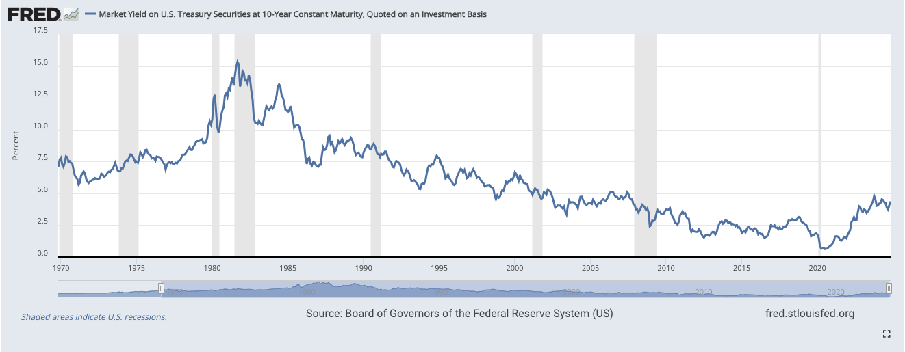
FRED API
Target & Macroeconomic Indicators
https://fred.stlouisfed.org/series/DGS10#0

Slide 5
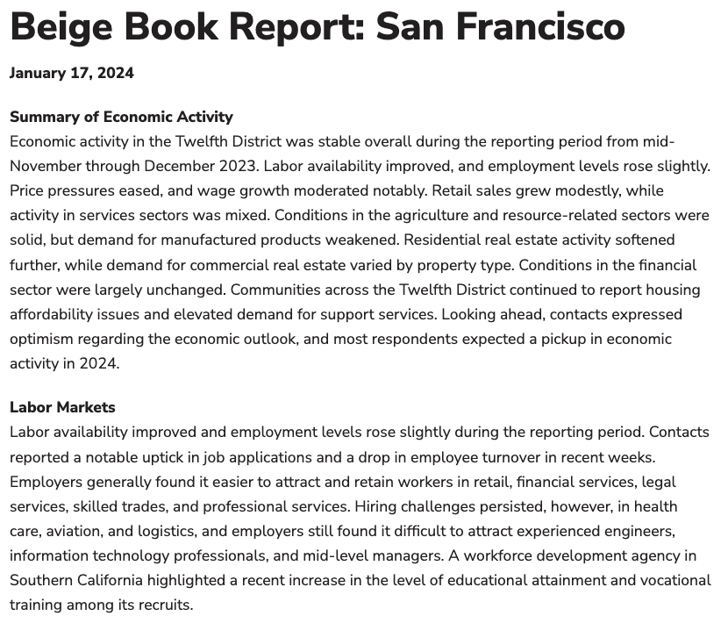
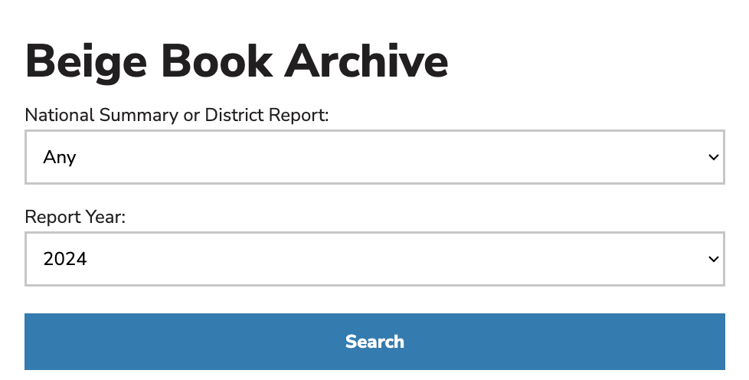
Federal Reserve Bank of Minneapolis
Beige Books
https://www.minneapolisfed.org/region-and-community/regional-economic-indicators/beige-book-archive

Slide 6
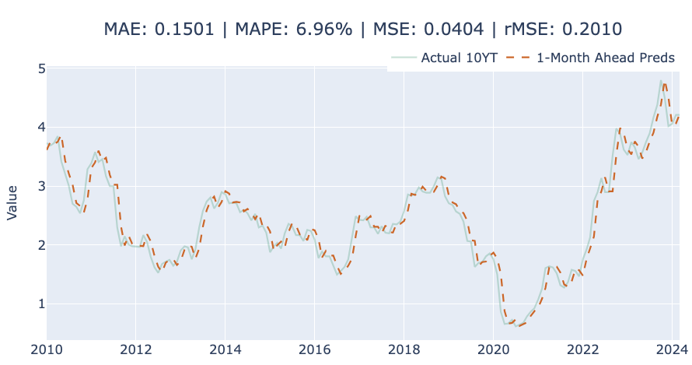
Baseline #1
AR(1) Process

Slide 7
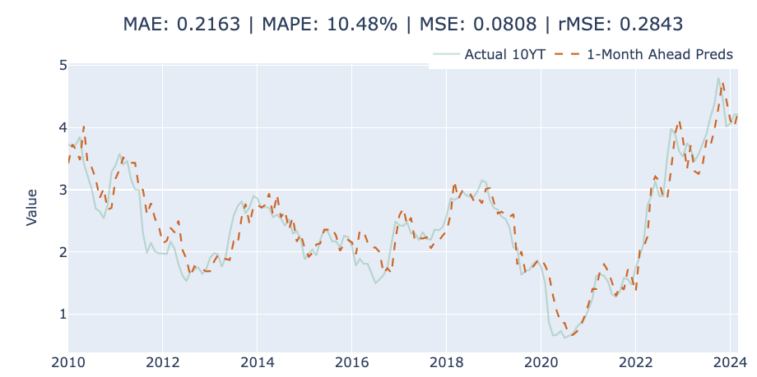
Baseline #2
XGBoost with Macroeconomic Indicators
10-YT, Consumer Price Index, Unemployment, Producer Price Index, Personal Savings Rate

Slide 8
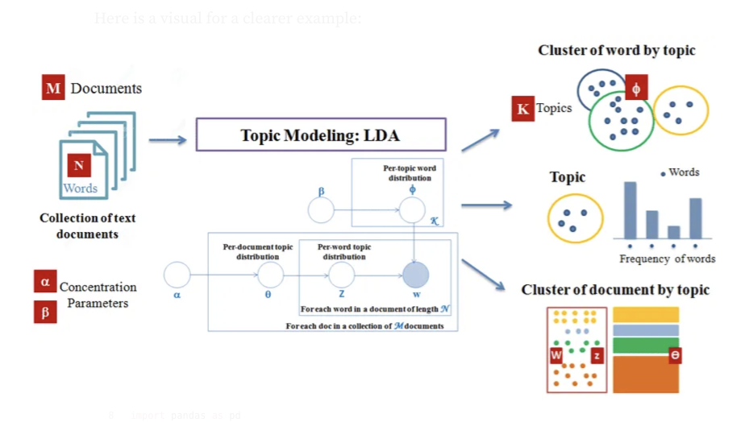
Topic Identification
Latent Dirichlet Allocation (LDA)
Source: https://medium.com/@robinsonjason761/nlp-for-topic-modeling-with-a-lda-technique-1fe4bec4e40

Slide 9
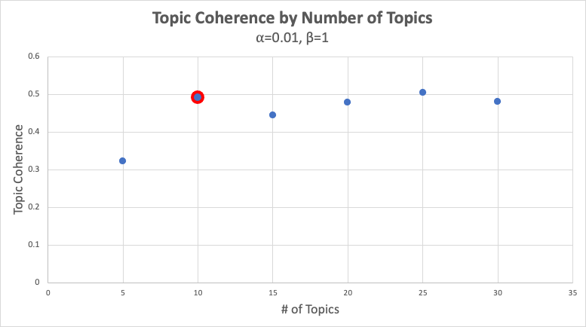
Topic Identification
Hyperparameter Tuning

Slide 10
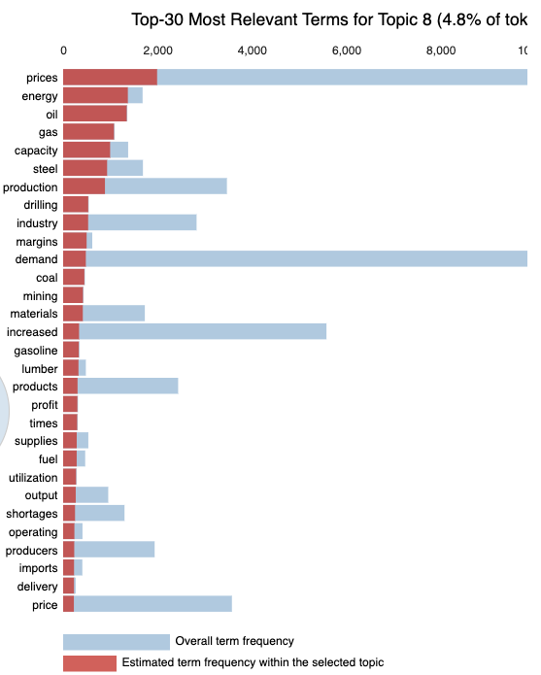
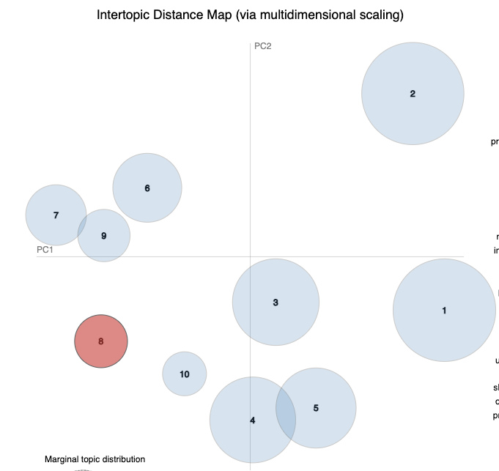
Topic Identification
Results
Topics: mortgages, consumer goods, wages, credit, agriculture, capital, energy, travel, services, and percent

Slide 11
Sentiment-Based Predictors
FinBERT
FinBERT “is a pre-trained NLP model to analyze sentiment of financial text… built by further training the BERT language model in the finance domain, using a large financial corpus and thereby fine-tuning it for financial sentiment classification”
Model pulled from HuggingFace, no further fine-tuning performed
Each sentence was labeled and scored using FinBERT
Example
May 1970 San Francisco
Sentence: “Severe gasoline price wars are evident in many locations, aggravated by the introduction of new types of gasoline.”
Topic: Energy
Sentiment: Negative, 0.95

Slide 12
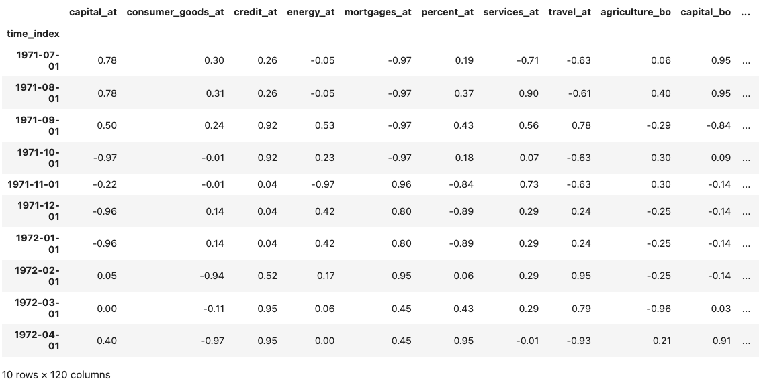
Sentiment-Based Predictors
Results

Slide 13
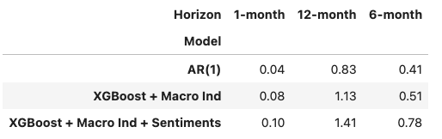
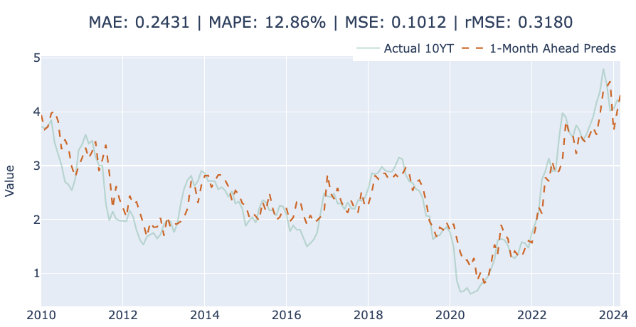
Results
XGBoost + Macroeconomic Indicators + Sentiments

Slide 14
Conclusions & Limitations
No improvement over baseline, reinforces use and continued relevance of traditional econometric models
Limitations to consider
FinBERT fine-tuned on Financial PhraseBank data set to interact with trading data not economic data
More thorough review of errors present when assigning topics to sentences using LDA
Feature selection to assess which sentiment-based predictors are most relevant in predicting 10-year yields

